Slide 1
Distributed FS Reliability
Demo 3
Akshay Katira, Sameer Sinha, Shilin Zhou, Xinyi Chen

Slide 2
Recap
Background
Develop Testing framework for targeted Distributed files system
Automate Infrastructure creation
Automate Infrastructure configuration and setup
Provide automated test scenarios
Provide APIs for interacting with the framework
Notes:
Integrate Terraform and Ansible with Python driver
Implement one end to end testing scenario
Design different failure scenario for MooseFS
A quick recap of our project. Our goal is to automate the configuration and infra setup, develop the testing frameworks for the targeted DFS, which is MooseFS in our case, and implementing APIs to interact with the framework.
For Sprint 1, we worked on understanding the requirements, learning Ansible and Terraform, and manually installing the MooseFS on MOC

Slide 3
Architecture Overview Recap
User
OpenStack
Management VM
1. Create VMs
2. Start VMs
Testing logic (Python)
Terraform (create, start, stop, destroy VMs)
7. Reboot one of the nodes
MFS master
Workflow API
9. destroy
Workflow Engine (Python)
metalogger
Ansible (configure VMs/environments)
3. Set up MFS servers
4. Run MFS
MFS chunk server 1
MFS chunk server …
SSH/SCP/SFTP
MFS client
Example test script (creates a 100GB file): #!/bin/bash dd if=/dev/urandom of=/mnt/mfs/test bs=10m count=10000 conv=sync
5. Upload scripts (optional)
6. Run test command/script
8. Check (e.g. by running a checker script)

Slide 4
Work Done this Sprint
Notes:
Move on to this sprint

Slide 5
Sprint 3 Tasks
Developed Python driver programs for Terraform, Ansible & Testing framework
Shifted from Java Main Driver program to Python
Integrated Terraform Driver program & Ansible Driver program in Main Driver Program
Integrated One end to end testing scenario in Main Driver Program
Designed different failure scenario for MooseFS
Notes:
Integrate Terraform and Ansible with Python driver
Implement one end to end testing scenario
Design different failure scenario for MooseFS

Slide 6
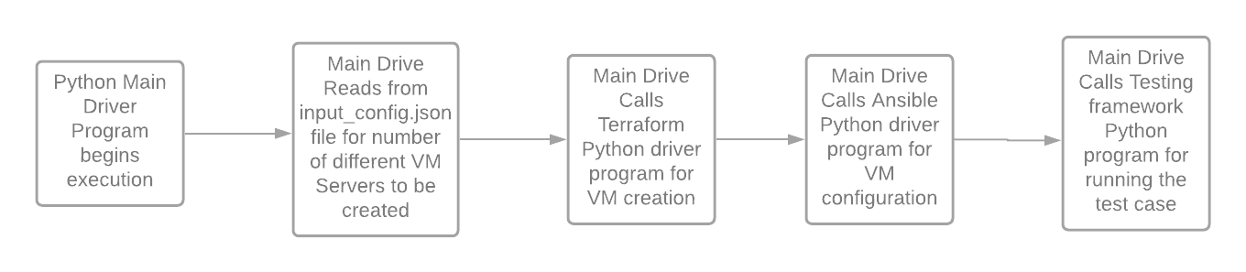
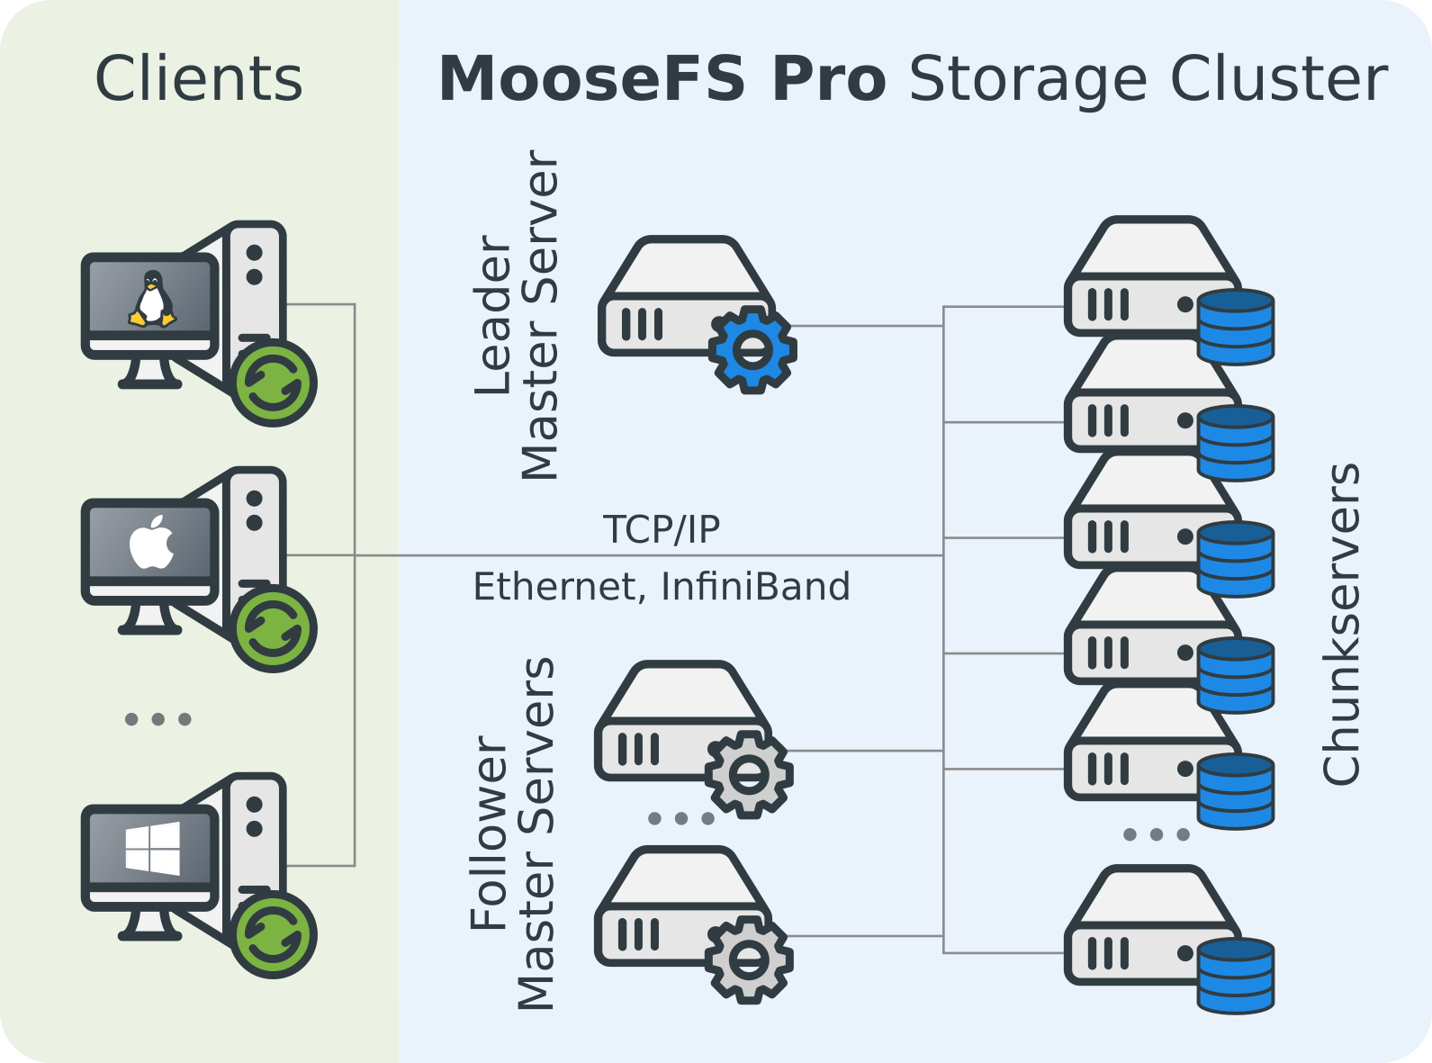
Control Flow Overview
Different MooseFS Servers:
Master Server
Metalogger
Chunk Server
Client Server

Slide 7
Demo
Notes:
Move on to this sprint

Slide 8


Slide 9
Failure Scenario 1
OpenStack
MFS Server Structure:
1 master + 1 metalogger + 3 chunkservers + 3 client servers
Management VM
1. Create VMs
2. Start VMs
MFS Servers
master
6. Shut down client1
Terraform (create, start, stop, destroy VMs)
8. destroy
metalogger
chunkserver 1
chunkserver 2
User
Workflow Engine (Python)
3. Set up MFS servers
4. Run MFS
Ansible (configure VMs/environments)
chunkserver 3
client 1
5. Add file w/ content through client1
SSH/SCP/SFTP
client 2
7. check file(content) on client2 & client3
client 3

Slide 10
Failure Scenario 2
OpenStack
MFS Server Structure:
1 master + 1 metalogger + 3 chunkservers + 3 client servers
Management VM
1. Create VMs
2. Start VMs
MFS Servers
master
7. Shut down one chunkserver
Terraform (create, start, stop, destroy VMs)
metalogger
9. destroy
chunkserver 1
chunkserver 2
User
Workflow Engine (Python)
3. Set up MFS servers
4. Run MFS
Ansible (configure VMs/environments)
chunkserver 3
client 1
5. Add file w/ content through client1
SSH/SCP/SFTP
client 2
6. Set replica goal = 2
8. check file(content) on all clients
client 3

Slide 11
Failure Scenario 3
OpenStack
MFS Server Structure:
1 master + 1 metalogger + 3 chunkservers + 3 client servers
Management VM
1. Create VMs
2. Start VMs
MFS Servers
master
6. Hard reboot master
Terraform (create, start, stop, destroy VMs)
8. destroy
metalogger
chunkserver 1
chunkserver 2
User
Workflow Engine (Python)
3. Set up MFS servers
4. Run MFS
Ansible (configure VMs/environments)
chunkserver 3
client 1
5. Add file w/ content through client1
SSH/SCP/SFTP
client 2
7. After master back online, check file(content) on all clients
client 3

Slide 12
Failure Scenario 4
OpenStack
MFS Server Structure:
1 master + 1 metalogger + 3 chunkservers + 3 client servers
Management VM
1. Create VMs
2. Start VMs
MFS Servers
master
7. Shut down client1 while writing
Terraform (create, start, stop, destroy VMs)
metalogger
9. destroy
chunkserver 1
chunkserver 2
User
Workflow Engine (Python)
3. Set up MFS servers
4. Run MFS
Ansible (configure VMs/environments)
chunkserver 3
client 1
5. Add file w/ char A through client1
SSH/SCP/SFTP
client 2
6. Make a call to replace all As with Bs
8. check file(content) on other clients
client 3

Slide 13
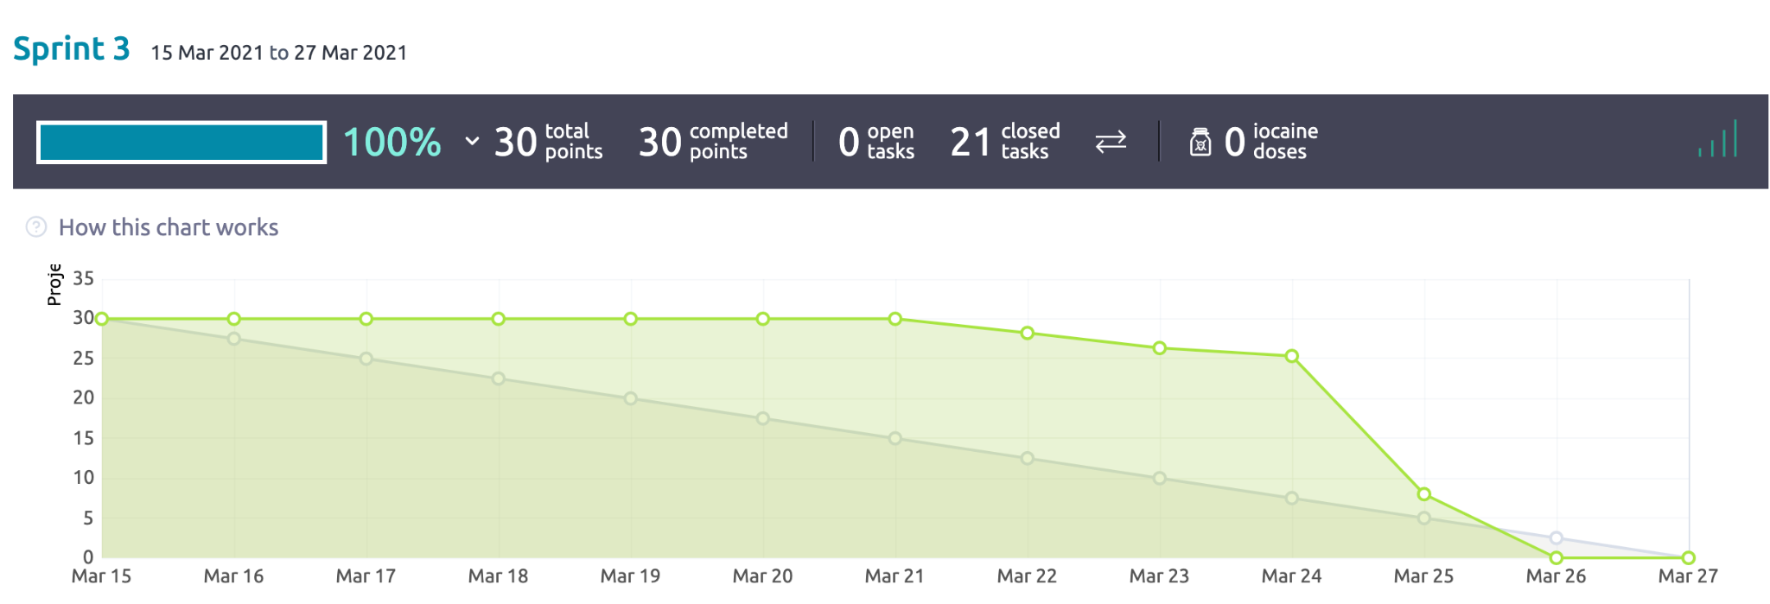
Sprint 3 Burndown Chart

Slide 14
Next Sprint
Implement all test case failure scenarios end to end
Documentation of the project workflow
Abstract & refactor existing implementation to consider for different file systems

Slide 15
Questions from the Audience

